Slide 1
NFC(Near-field communication)
Near-field communication (NFC) is a set of communication protocols for communication between two electronic devices over a distance of 4 cm (1¹⁄₂ in) or less.NFC offers a low-speed connection with simple setup that can be used to bootstrap more-capable wireless connections.

Slide 2
NFC devices can act as electronic identity documents and keycards. They are used in contactless payment systems and allow mobile payment replacing or supplementing systems such as credit cards and electronic ticket smart cards. This is sometimes called NFC/CTLS or CTLS NFC, with contactless abbreviated CTLS. NFC can be used for sharing small files such as contacts, and bootstrapping fast connections to share larger media such as photos, videos, and other files.

Slide 3
Near-field communication (NFC) describes a technology which can be used for contactless exchange of data over short distances. Two NFC-capable devices are connected via a point-to-point contact over a distance of 0 to 2 cm. This connection can be used to exchange data (such as process data and maintenance and service information) between the devices. This interface can be used for parameterization of the component as well.
NFC-enabled portable devices can be provided with application-software, for example to read electronic tags or make payments when connected to an NFC-compliant system. These are standardized to NFC protocols, replacing proprietary technologies used by earlier systems.
Like other “proximity card" technologies, NFC is based on inductive coupling between two so-called antennas present on NFC-enabled devices—for example a smartphone and a printer—communicating in one or both directions, using a frequency of 13.56 MHz in the globally available unlicensed radio frequency ISM-band using the ISO/IEC 1800-3 air interface standard at data rates ranging from 106 to 424 kbit/s.

Slide 4
Every active NFC device can work in one or more of three modes:
NFC card emulation
Enables NFC-enabled devices such as smartphones to act like smart cards, allowing users to perform transactions such as payment or ticketing. See Host card emulation
NFC reader/writer
Enables NFC-enabled devices to read information stored on inexpensive NFC tags embedded in labels or smart posters.
NFC peer-to-peer
Enables two NFC-enabled devices to communicate with each other to exchange information in an ad hoc fashion

Slide 5
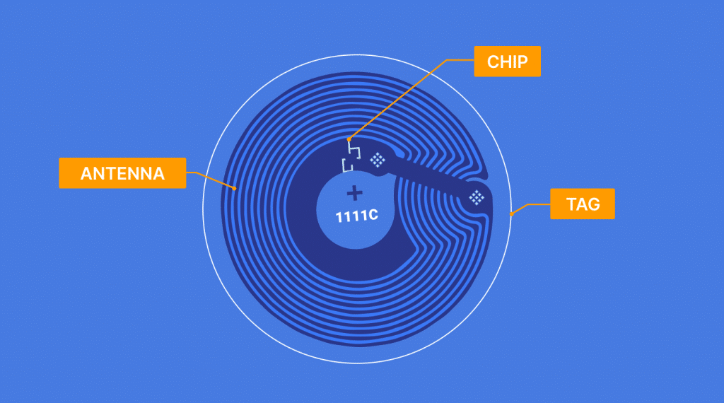
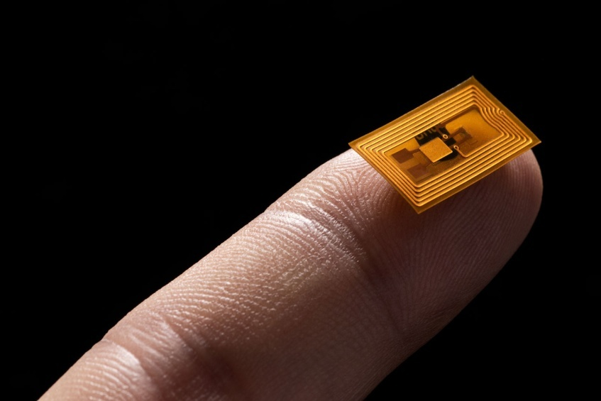
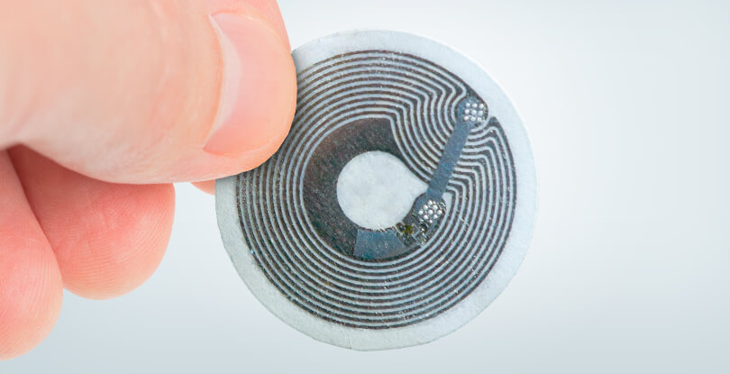
NFC

Slide 6
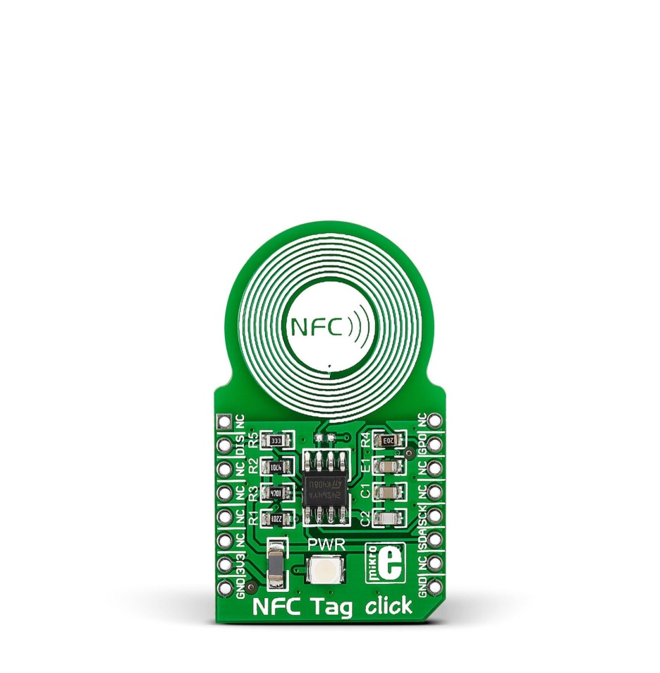
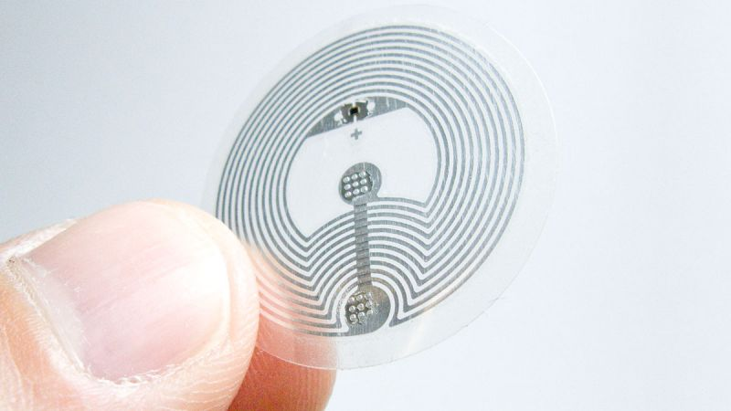
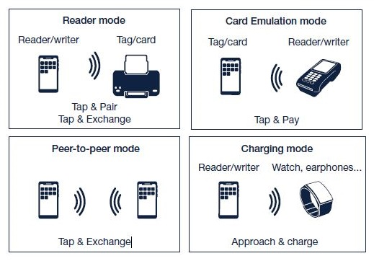
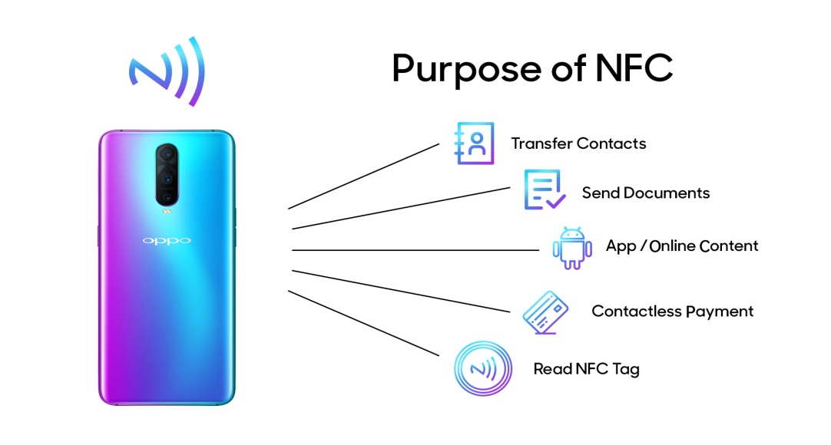

Slide 7
DESIGN:
NFC operates at 13.56 MHz on ISO/IEC 18000-3 air interface and at rates ranging from 106 kbit/s to 424 kbit/s. NFC always involves an initiator and a target; the initiator actively generates an RF field that can power a passive target. This enables NFC targets to take very simple form factors such as unpowered tags, stickers, key fobs, or cards. NFC peer-to-peer communication is possible, provided both devices are powered
NFC tags contain data and are typically read-only, but may be writable. They can be custom-encoded by their manufacturers or use NFC Forum specifications
As with proximity card technology, NFC uses inductive coupling between two nearby loop antennas effectively forming an air-core transformer. Because the distances involved are tiny compared to the wavelength of electromagnetic radiation (radio waves) of that frequency (about 22 meters), the interaction is described as near field.
Speed (kbit/s) | Active device | Passive device
424 | Man, 10% ASK | Man, 10% ASK
212 | Man, 10% ASK | Man, 10% ASK
106 | Modified Miller, 100% ASK | Man, 10% ASK

Slide 8
Standards
NFC standards cover communications protocols and data exchange formats, and are based on existing RFID standards including ISO/IEC 14443 and FeliCa. The standards include ISO/IEC 18092 and those defined by the NFC Forum.
1)ISO\IEC
2)GSMA
3)SToLPaN
3)NFC Forum

Slide 9
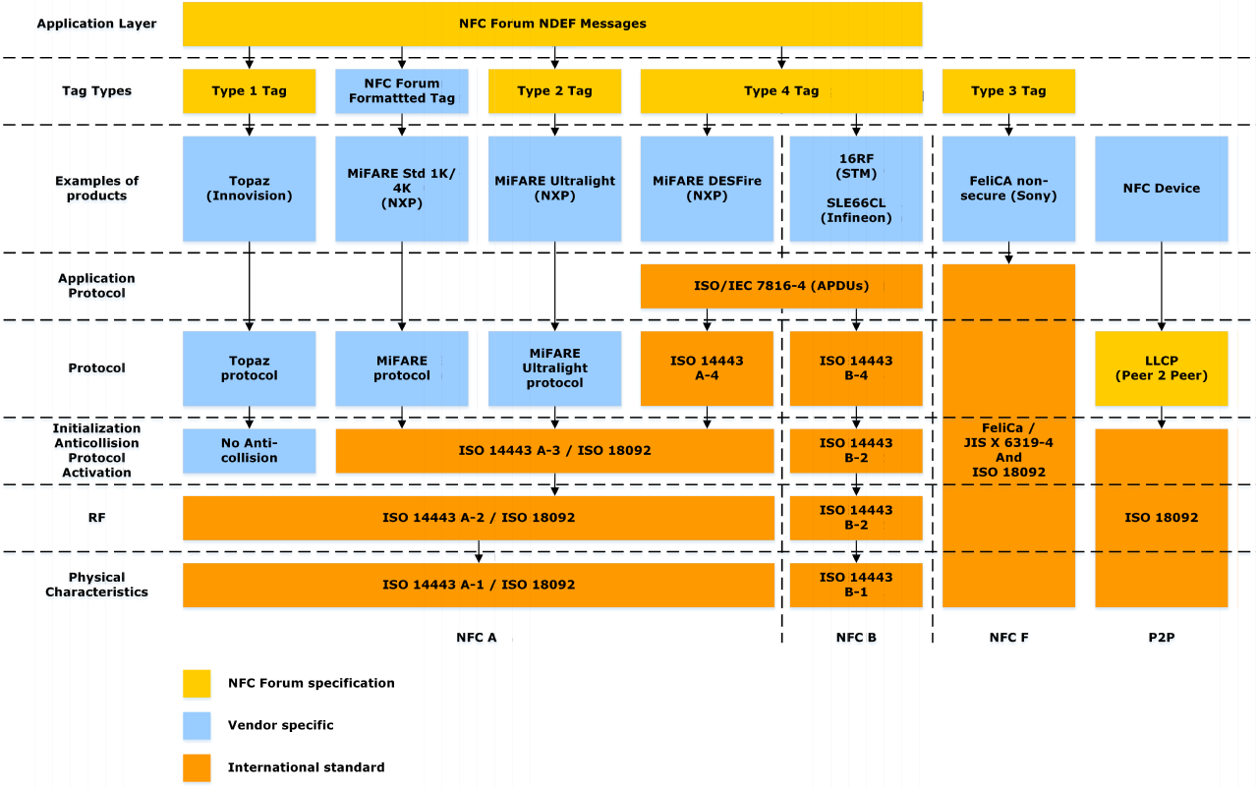

Slide 10
APPLICATIONS
1)Commerce: Contactless payment systems,credit cards,electronic ticket smart cards Eg: Apple pay
2)Social Networking: Transfer of files,photos,videos and multiplayer mobile games
3)Identity: ID cards,passports,keycards,car key,Access badges
4)Sports: Adidas Telstar 18 uses NFC to show where the ball is to television audience
DEPLOYMENTS
1)China Telecom-The company signed multiple banks to make their payment apps available on its sim cards
2)Sri Lanka first workforce smart cards uses NFC
3)NFC ticketing system was made in use in Germany,Australia,New Zealand,Iran,Italy,Turkey,Greece
4)NFC sticker based payments in Australia’s bank enabling users to make contactless payments using a smart sticker stuck to their phone
5)India implements NFC based transactions at boxoffice and theaters for ticketing purposes

Slide 11
CRITICISM
1)Standard plain NFC is not protected to Eavesdropping,Applications must use higher layer cryptographic protocols to establish secure connection
2)Relay attacks also called as man in the middle attack,where data can be modified,stolen,or pretend to be sender or receiver.
FUTURE CONSIDERATIONS
1)Ultrawide band is being developed as a future alternative for NFC,Bluetooth due to further distances of data transmission

